Slide 1
Lecture 9: Models of Cloud Computing

Slide 2
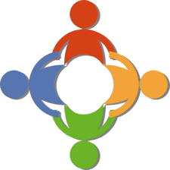
Many different classifications based on different viewpoints

Slide 3
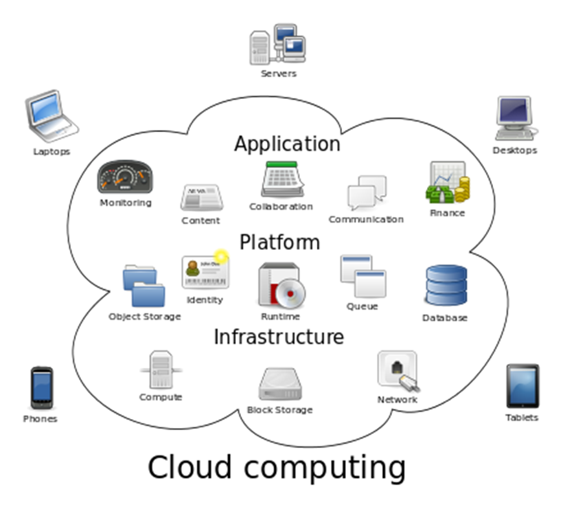
Delivery Models/ Service Levels
Software as a Service (SaaS)
Can access software through cloud client
Instant access, pay as use/subscription
Microsoft office 365 – edit/save files on the cloud
Platform as a Service (PaaS)
Full computing platform with OS provided
Develop apps without worrying about setting up servers etc.
Access to tools/libraries from the provider
Create/deploy software from anywhere
Infrastructure as a Service (IaaS)
Include hardware/storage/servers
Host/maintain/secure by the company/provider
Examples: OnLive (rent computers to play games), Dropbox (rent storage)

Slide 4
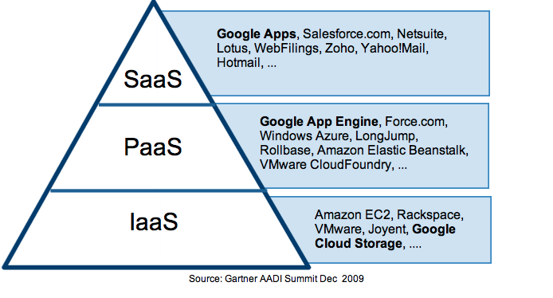
Cloud Computing Service Levels

Slide 5
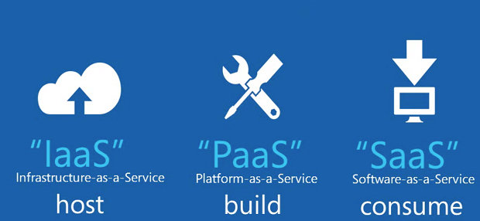
IaaS, PaaS, SaaS

Slide 6
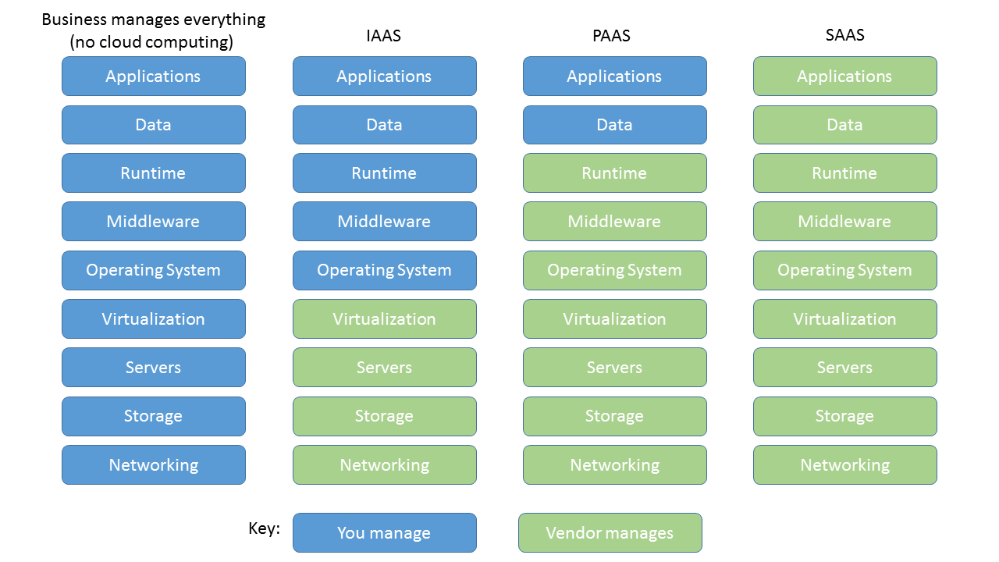
Management Responsibility of Services
https://carlfreeman.net/

Slide 7
What is SaaS
Software as a service
software and associated data are centrally hosted on the cloud
By independent software vendors or application service providers
typically accessed by users using a thin client thin via a web browser
a common delivery model for many business applications
office & messaging software, DBMS software, management software, CAD software, Development software, ...
potential to reduce IT support costs by outsourcing hardware and software maintenance and support to the SaaS provider.

Slide 8
SaaS Examples
Email
Google (Gmail), …
CRM (Customer relationship management software)
Salesforce, …
Office Apps
Microsoft (Office Live), …

Slide 9
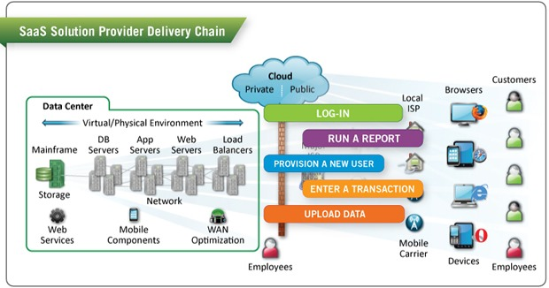
Understand SaaS
Software are hosted on cloud and managed by cloud provider;
Users access the software via a public interface provided by the cloud provider.
zdnet.com

Slide 10
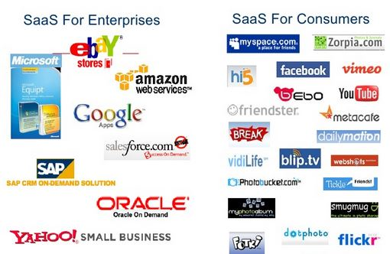
SaaS Sample Products

Slide 11
Activity #1
Which of the following is not a SaaS service?
GoToMeeting.com
Adobe photoshop
Google App Engine
Evite
True or False.
Clients of a SaaS service can manage the data on the server but not the application nor the operating system.
If a business doesn’t go with cloud services, it has to manage everything including application, data, middleware, networking, … all by itself.

Slide 12
What is PaaS
A category/model of cloud computing services
provides computing platform and solution stack as service
consumer creates software using tools/libraries from the provider
consumer controls software deployment and configuration settings.
Provider provides the networks, servers, storage, etc. required to host the consumer's application.
Consumer avoids the cost and complexity of buying and managing the underlying hardware and software
Offers varying levels of scalability and maintenance.
Supports application design, application development, testing, deployment, monitoring, workflow management, as well as services such as team collaboration, web service integration, …

Slide 13
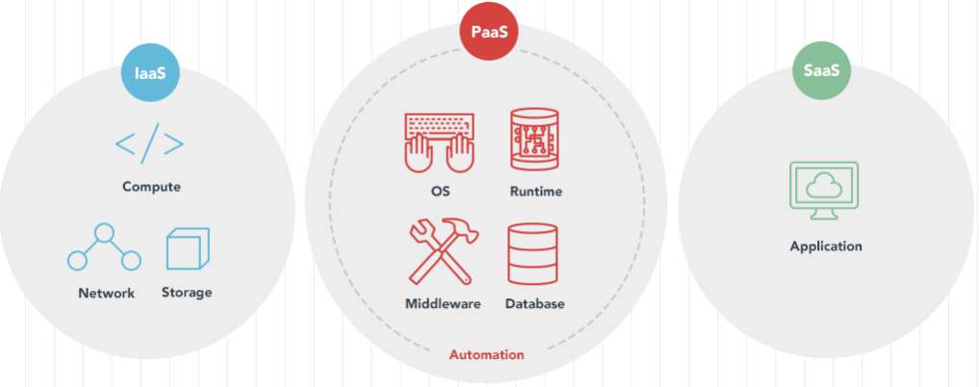
Understand PaaS
Computing resources, storage and networking facilities are hosted and managed by a service provider; customers are able to install software and create applications on top of these facilities.
https://www.salesforceben.com/

Slide 14
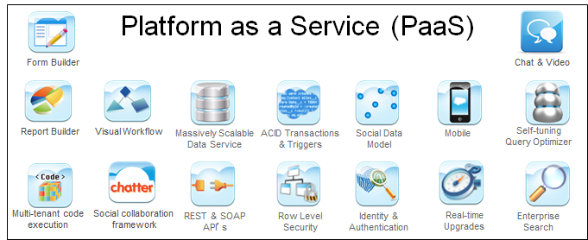
PaaS Examples
Application Servers
Google App Engine
Engine Yard and Heroku (Ruby development)
Databases
Middleware

Slide 15
PaaS vs. Middleware
Middleware is a software layer that offers sophisticated features to developers
transactions, security, clustering, etc.
focus on building their custom applications instead of solving those hard problems repeatedly
middleware is only "static" software in the sense that you still have to configure it, deploy it on servers, manage and monitor it, which was typically left to IT teams to do.
PaaS is a superset of middleware and offers all these good middleware services to developers, in addition to covering the operational aspects that were typically owned by IT teams.

Slide 16
What is IaaS
It is a standardized, highly automated offering of infrastructure/hardware resources
Computing resources, storage and networking capabilities are owned and hosted by a service provider and offered to customers on-demand
Customers are able to self-provision this infrastructure
using a Web-based graphical user interface that serves as an IT operations management console for the overall environment.
API access to the infrastructure may also be offered as an option.

Slide 17
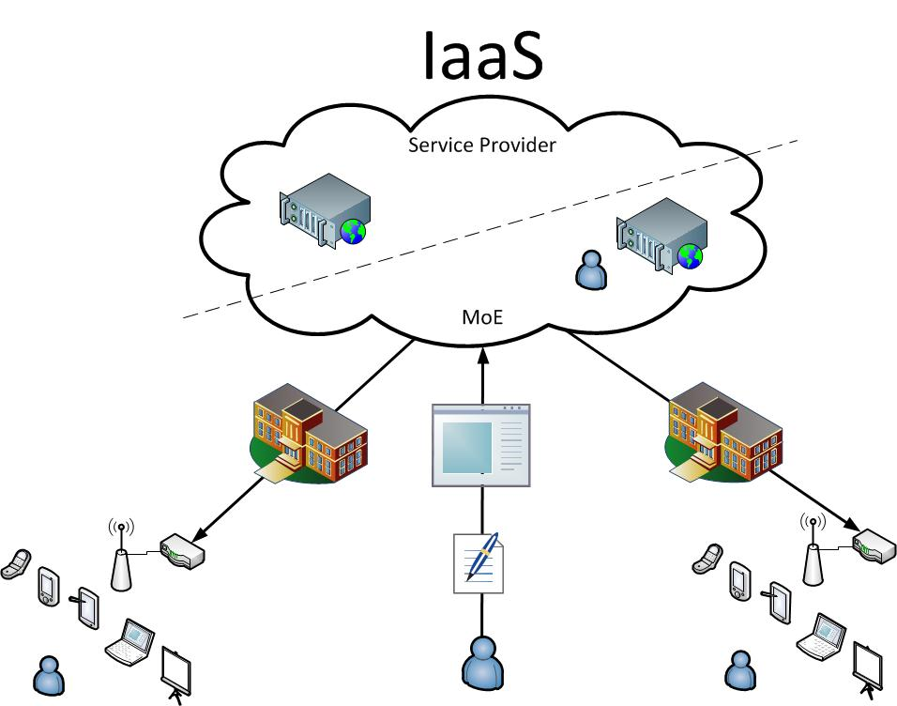
Understand IaaS
Computing resources, storage and networking capabilities are owned and hosted by a service provider and offered to customers on-demand; Customers are able to configure and self-manage this infrastructure.

Slide 18
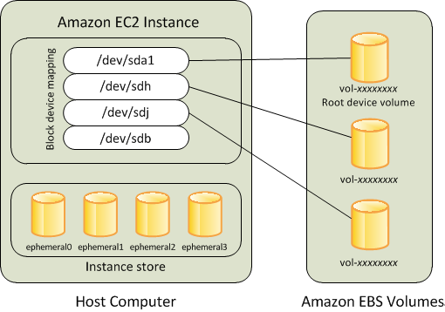
IaaS Examples
IaaS
sort of renting bare hardware
Examples
Amazon EC2 (Elastic Compute Cloud)
Rackspace
GoGrid
aws.amazon.com

Slide 19
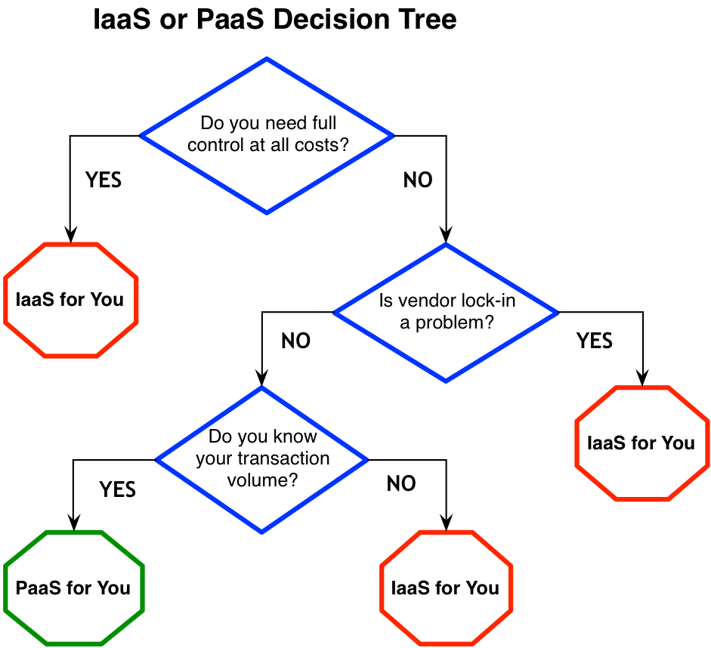
IaaS or PaaS: Which service to choose?
http://www.gregarnette.com/

Slide 20
Activity #2
Identify service model/level for each of the following cloud service:(note: some may be used for multiple services)
Office 365 subscription
Microsoft Azure
Adobe photoshop
Amazon AWS
Cisco WebEx or GoToMeeting
True or False
PaaS users are able to manage the application and data on the cloud server.
PaaS users are also able to manage the operating systems on the cloud server.
IaaS users are able to configure the networking on the cloud server.

Slide 21
Comparison: SaaS, PaaS, IaaS
Cloud Service Model | Typical Level of Control Granted to Cloud Consumer | Typical Functionality Available to Cloud Consumer
SaaS | Usage or usage related configuration | Access to front-end user-interface
PaaS | Limited administrative | Moderate level of control over IT resources related to cloud consumer’s usage of platform
IaaS | Full administrative | Full access to virtualized infrastructure-related IT resources, possibly to underlying physical IT resources

Slide 22
Typical activities: SaaS, PaaS, IaaS
Cloud Service Model | Common Cloud Consumer Activities | Common Cloud Provider Activities
SaaS | Uses and configures cloud service | Implements, manages, and maintains cloud service; monitors usage by cloud consumers
PaaS | Develops, tests, deploys, and manages cloud services and cloud-based solution | Pre-configures platform, middleware, and other needed IT resources; Monitors usage by cloud consumers
IaaS | Sets up and configures bare infrastructures and installs, manages, and monitors any needed software | supplies and manages the physical processing, storage, networking and hosting required; Monitors usage by cloud consumers

Slide 23
Sample Contracts
Cloud Service Model | Sample contract
IaaS | Product: virtual server, 32GB RAM, 4 GB local storage, … SLA (service-level agreement): availability 99.5%, no failover Price: $0.95 per hour, $0.05 per GB transferred out of cloud
PaaS | Product: application server, DBMS platform, … SLA: availability 99.5%, auto-scaling Price: $0.45 per hour (max 500,000 requests)
SaaS | Product: … SLA: response time 0.5ms Price: $0.05 per 100 requests

Slide 24
Activity #3: SaaS, PaaS, or IaaS
On a cloud service, if I could perform such actions, this service should be classified as SaaS, PaaS, or IaaS?
I could install a virtual machine on it.
I could develop an application on it using Java.
I could access its storage (i.e. to store photos there) via its web interface.
I could configure network and processor nodes.

Slide 25
New Models …
Data as a service (DaaS)
A cousin of software as a service (SaaS)
DaaS builds on the concept that data can be provided on demand to the user regardless of geographic or organizational separation of provider and consumer.
Database as a service (DBaaS)
DBaaS provides users with some form of access to a database without the need for setting up physical hardware, installing software or configuring for performance.
Functions as a service (FaaS)
FaaS provides a platform allowing customers to develop, run, and manage application functionalities without the complexity of building and maintaining the infrastructure typically associated with developing and launching an app.

Slide 26
Deployment Models
Public Cloud
Community Cloud
Private Cloud
Hybrid Cloud
https://www.supinfo.com/

Slide 27
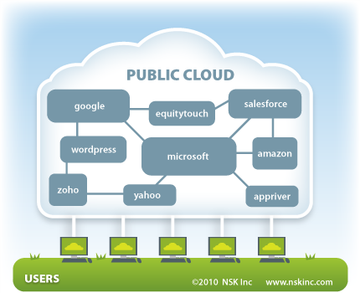
Public Cloud
A pool of computing services delivered over the Internet
Available to the general public or a large industry group

Slide 28
Public Cloud Features
Most common
Owned by a public cloud provider selling cloud services
Offered by a vendor, who typically uses a “pay as you go” or “metered service” model
Advantages
Pay for resources you consume
Quick deployment
Capacity scaling
All services are delivered with consistent availability, resiliency, security, and manageability

Slide 29
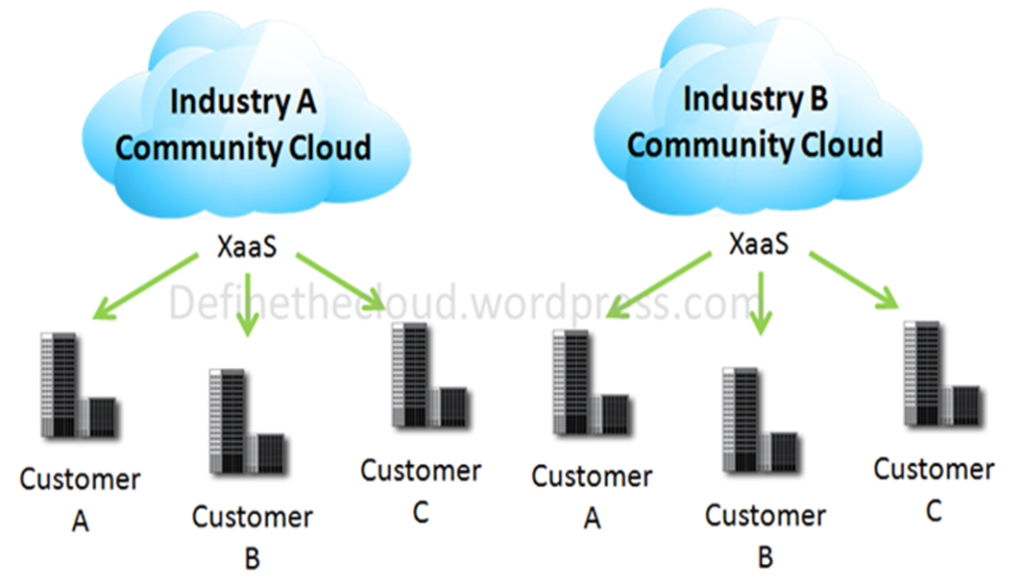
Community Cloud
Shared/owned by several organizations
Supports a specific community that has shared concerns
mission, security requirements, policy, and compliance considerations
May be managed by the organizations or a third party and may exist on premise or off premise

Slide 30
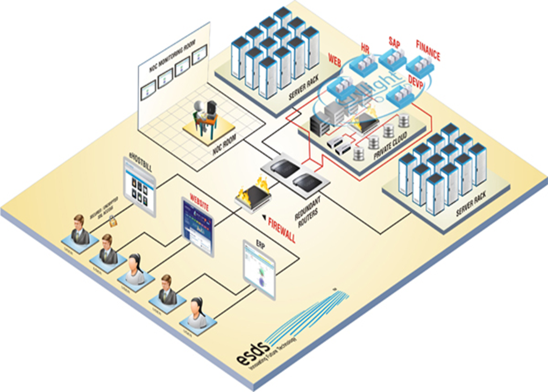
Private Cloud
Computing resources/services architectured/operated solely for an organization
Typically owned by the organization
Virtual private cloud (also dedicated cloud or hosted cloud)
Hosted and managed by public cloud provider and made available to a (specific) organization
Built onsite or hosted off premise
Managed by itself or third party
Full control and safe

Slide 31
Who should use private cloud?
Examples
banks and governments have data security issues that may preclude the use of currently available public cloud services.

Slide 32
Hybrid Cloud
A composition of two or more clouds (private, community, or public)
For example, one organization uses one cloud service on public cloud (hosting public data) and also hosts a private cloud hosting sensitive data
Example: Harvard university keeps all the election data
https://guides.library.harvard.edu/c.php?g=310717&p=2072692

Slide 33
Hybrid Cloud Features
Remain unique entities but are bound together by standardized or proprietary technology
Private for important information, public if unnecessary
Enables data and application portability
e.g., cloud bursting for load balancing between clouds

Slide 34
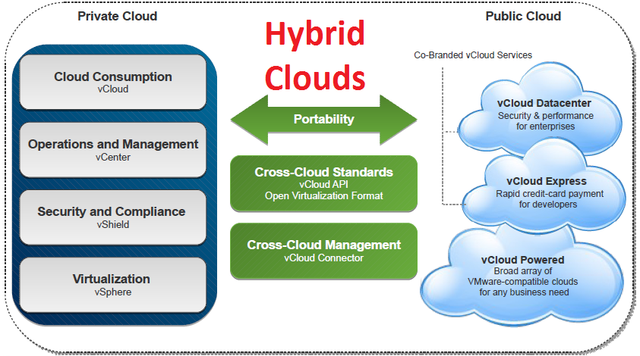
A hybrid cloud is the composition of private cloud and public cloud; it benefits from feature of both private and public clouds .
http://vigilant1.com/

Slide 35
Activity #4:
Each of the following is a term of service model or deployment model?
DaaS
PaaS
Community
Hybrid
If we’d build a cloud system for all the universities in your province to use, what kind of deployment model is most proper? Why?

Slide 36
Building your own Cloud (optional – FYI only)
You may try it for fun, but tons of questions and problems will come up!

Slide 37
Building your own cloud
How to build your open private cloud
on your own hardware in your own institution?
could also be on top of another public cloud.
How to build your own software as a service (SaaS) systems that run on public clouds?

Slide 38
Building Private Clouds: Tools
OpenStack https://openstack.org
open source project
for building private and public clouds
OpenNebula https://opennebula.org
Open source cloud project
Simplify the process for building private cloud
Provide a set of services integrating existing data center
Eucalyptus
Open source for building private and hybrid clouds
Compatible with Amazon AWS
Very popular
Apache CloudStack https://cloudstack.apache.org
Azure Stack
Microsoft
VMWare Cloud Foundation

Slide 39
Cloud IaaS Abstraction
Typical for private cloud
A VM image (Linux or Window)
A fixed number of virtual CPUs and a fixed size memory partition
One or more disk partitions
A public and a private IP address for the VM
A MAC address for network requests
A set of firewall rules

Slide 40
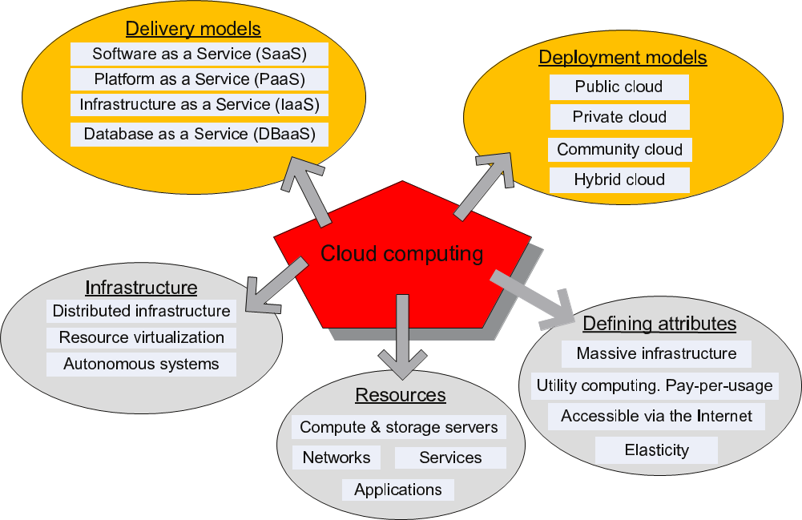
Conclusion: what we covered in this lecture

Slide 41
Summary
Cloud models
Cloud delivery models or service levels, and deployment models
Assignment
Complete all activities.
Exploring cloud services provided by AWS S3.
Next Lecture
Main developments of cloud computing

